Slide 1

Unpacking Identity Vulnerability: Predicting Discrimination and Violence against LGBTIQ+ Individuals
Wendi Xue
Notes:
Hello everyone, this is Wendi, and today I will present my study on predicting discrimination and violence against LGBTIQ+ individuals using machine learning methods.

Slide 2
Research Question
How do gender identity, economic status, and minority identity influence the likelihood of experiencing discrimination and violence among LGBTIQ+ individuals?
Which social factors play the most significant role in predicting discrimination and violence levels?
Notes:
"LGBTIQ+ individuals experience different levels of discrimination and violence, but what determines these differences?"
"This study aims to answer two key questions:"
How do gender identity, economic status, and minority identity influence the likelihood of experiencing discrimination and violence?
Which social factors are the strongest predictors of these experiences?

Slide 3
Hypohesis
Who is most vulnerable to discrimination and violence?
🌈 Transgender / Non-binary individuals
💰❌ Low-income individuals
⚠️ Multiply marginalized groups
Notes:
Based on prior research, I hypothesize that:"
Transgender and non-binary individuals face the highest risk of discrimination and violence.
Low-income individuals are more vulnerable.
Multiply marginalized groups experience compounded discrimination.
"To test these hypotheses, I use large-scale survey data and machine learning models."

Slide 4
Introduction of Dataset
EU LGBTIQ Survey III (2023)
a large-scale cross-sectional survey conducted by the European Union Agency for Fundamental Rights (FRA)
Number of Respondents (Units of Analysis): 100,577 individuals
Notes:
I use the EU LGBTIQ Survey III (2023), which contains responses from over 100,000 individuals across Europe.
🔹 This dataset provides rich information on discrimination and violence experiences, along with various demographic, economic, and social identity factors.

Slide 5
Core Independent Variables
Variable | Category | Count
Economic Level | With Some Difficulty | 23511
 | Very Easy | 9645
 | Easy | 21677
 | Fairly Easy | 30190
 | With Difficulty | 9001
 | With Great Difficulty | 4225
Variable | Category | Count
Gender | Woman / Girl | 39534
 | Man / Boy | 33520
 | Trans woman / girl | 3101
 | Trans man / boy | 4283
 | Non-binary/fluid | 18155
Sexuality | Lesbian | 20813
 | Gay | 28770
 | Asexual | 24591
 | Bisexual | 12725
 | Pansexual | 8081
 | Heterosexual/Straight | 881
 | Other | 2700
Minority | No minority | 74815
 | Skin color only | 801
 | Ethnic/migrant only | 3965
 | Religious only | 2572
 | Disability only | 8869
 | Refugee/Asylum seeker | 320
 | Multiple minorities | 2989
 | Other minority | 4262
Notes:
Core Independent Variables
gender identity， economic status, and minority identity
the sample sizes of minor groups like trans or multiple minorities are pretty small compared to other groups. It also leads to problem when predicting.

Slide 6
Independent Variables
1. Demographics
Age (Continuous)
Country (e.g., Germany, Finland, France, Albania)
Marital Status (Single, Married, Cohabiting, etc.)
Religion (Religious affiliation or none)
Education (Highest level attained)
2. Socioeconomic & Living Conditions
Residence (Urban vs. rural living situation)
Location Comfort (Perceived safety in one's residence)
Health Status (Self-reported general health)
Life Satisfaction (Self-reported well-being)
3. Identity & Social Experience
Outness Mean (Degree of openness about identity)
Disclosure Locations (Safe places for identity disclosure)
Coming Out Age (Age of public identity disclosure)
PDA Comfort (Ease with public affection, indicating safety perception)
Notes:
Demographics (age, country, education, marital status, religion).
Socioeconomic & Living Conditions (residence type, economic status, life satisfaction, location comfort).
Identity & Social Experience (outness, disclosure locations, PDA comfort, coming-out age).

Slide 7
Dependent Variable —— Discrimination
Respondents were asked whether they personally felt discriminated against because of their sexual orientation, gender identity, or intersex status in any of the following contexts (multiple-choice question):
Employment: When looking for a job or at work
Housing: When looking for a house or apartment to rent or buy
Healthcare: By healthcare or social services personnel
Education: By school or university personnel, as a student or parent
Public Spaces & Services: At a café, restaurant, bar, nightclub, or shop
Government & Bureaucracy: In contact with administrative offices or public services, or when showing an ID or official document
Notes:
Discrimination – Self-reported experiences in employment, housing, healthcare, education, public spaces, and government services.

Slide 8
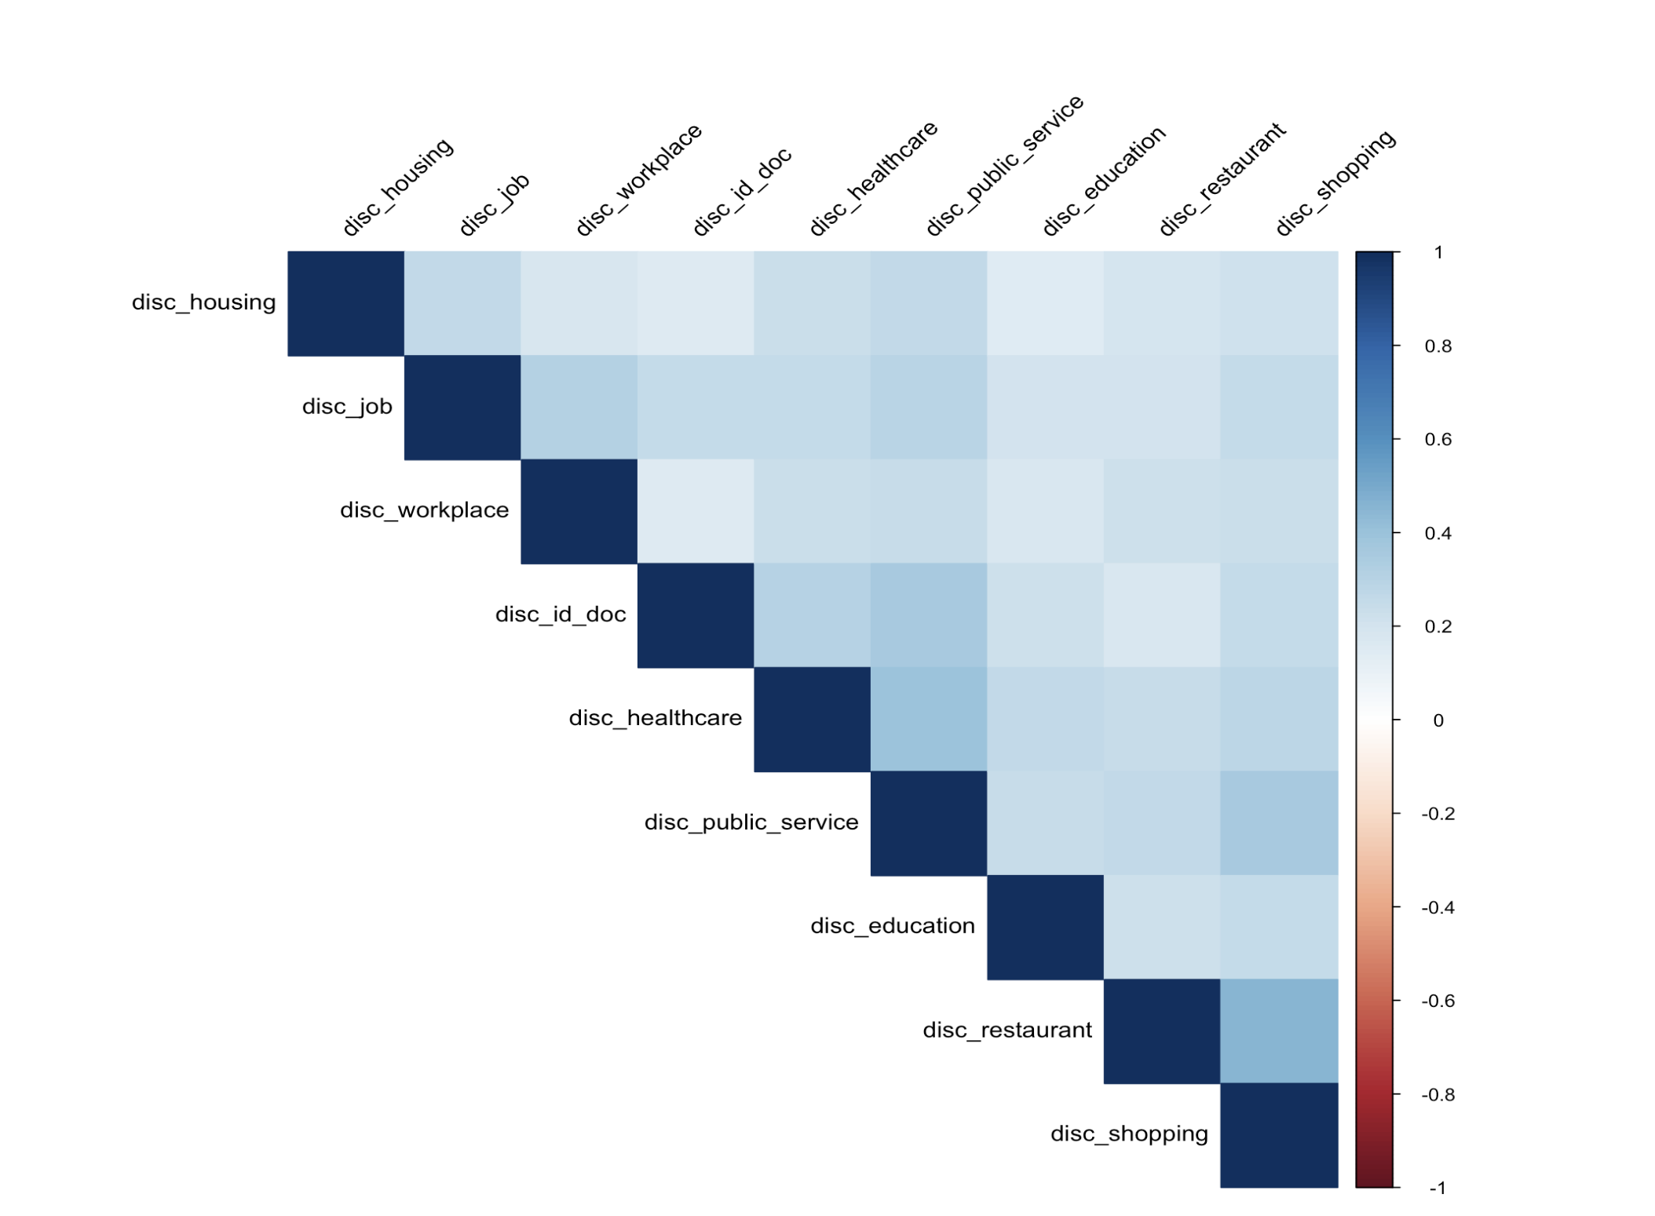
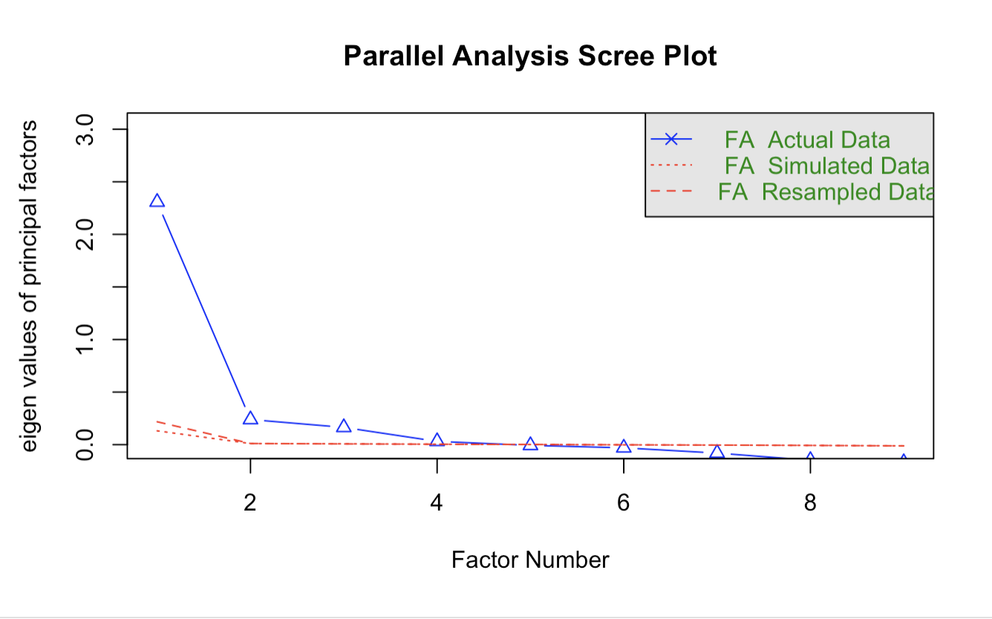
Factor Analysis —— Discrimination
Notes:
Since these discrimination variables were highly correlated, factor analysis was conducted to determine whether they could be combined into a single measure.
The heatmap of correlation coefficients shows strong relationships between the variables
the screen plot below shows that the first factor has a dominant eigenvalue, capturing most of the variance across the discrimination contexts

Slide 9
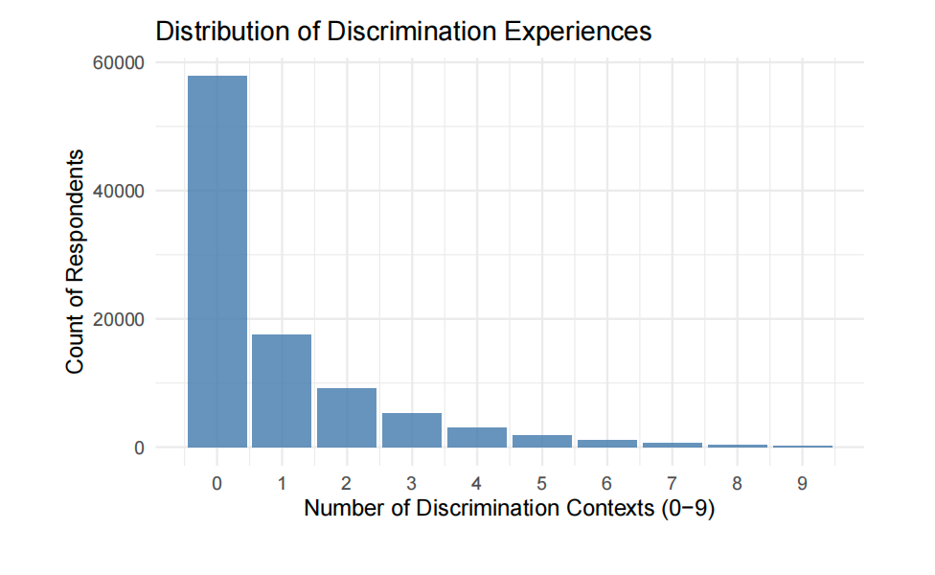
Feature Engineering —— Discrimination
Notes:
Given the results of the factor analysis, we created a composite variable called “Total Number of Discrimination Contexts” (variable name: disc_total).
this chart shows that While discrimination is not uniformly experienced, a subset of LGBTIQ+ individuals faces widespread and systemic mistreatment across different areas of life.

Slide 10
Dependent Variable —— Violence
In the last five years, how many times have you been physically or sexually attacked at home or elsewhere (on the street, public transport, workplace, etc.) because you are LGBTIQ?
0 = Never
1 = Once
2 = Twice
3 = 3–5 times
4 = 6–10 times
5 = More than 10 times
6 = All of the time
Notes:
captures self-reported experiences of violence against LGBTIQ+ individuals over the past five years.

Slide 11
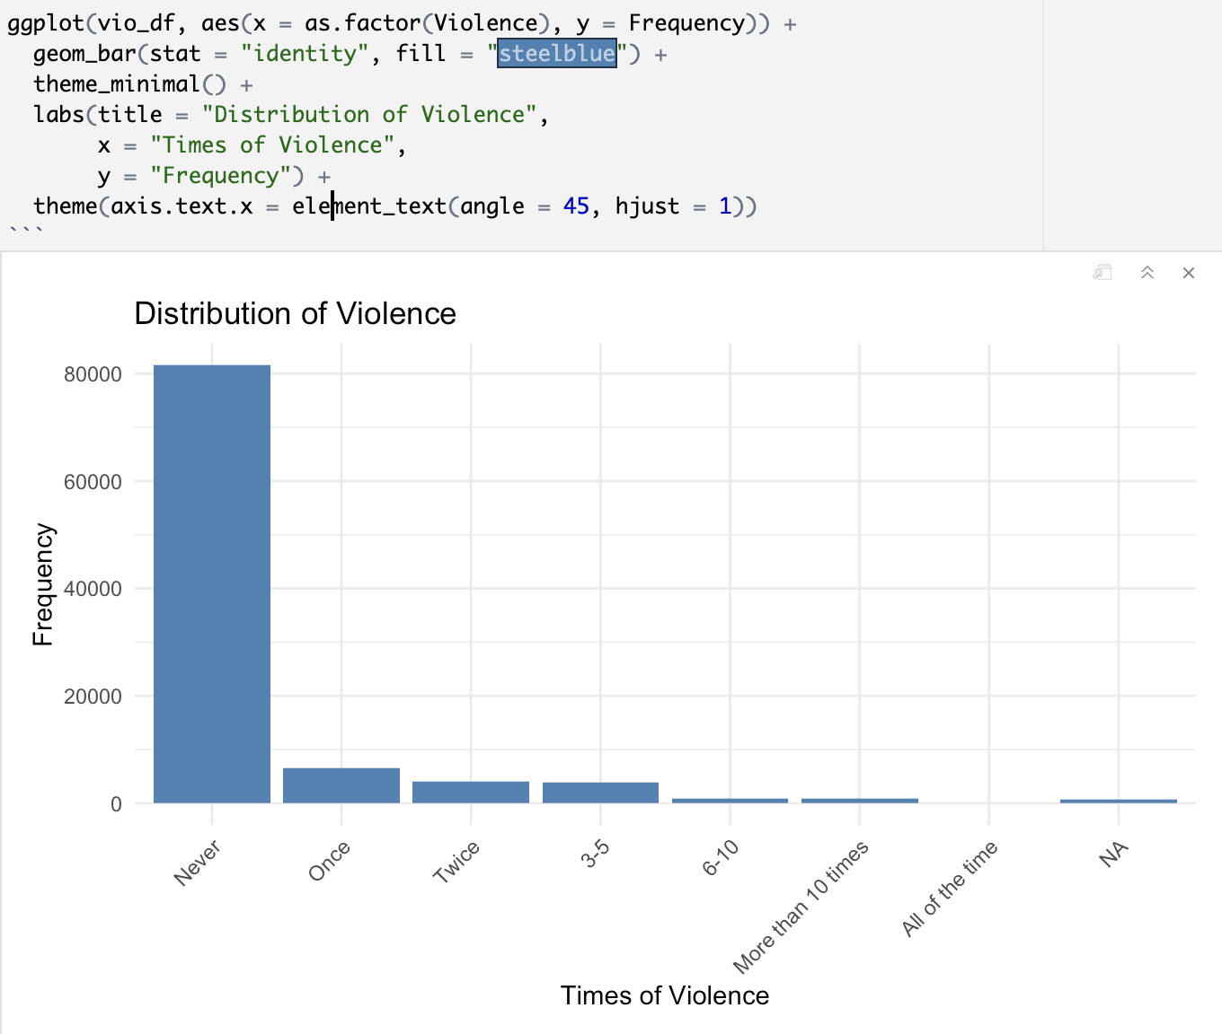
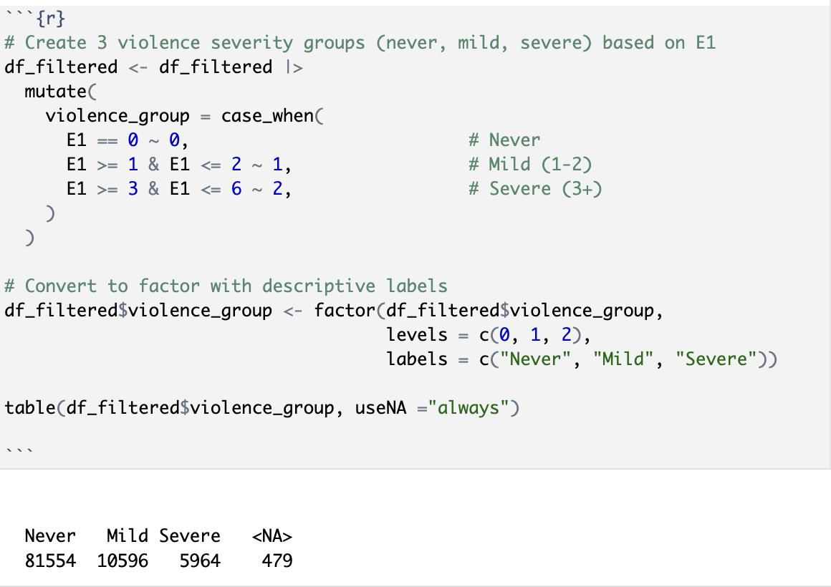
Feature Engineering —— Violence
Notes:
As shown in the bar chart, this variable is highly skewed,
To facilitate predictive modeling, we restructured this variable into a categorical format through feature engineering. Specifically, we grouped the responses into three categories
This transformation improves the balance of the variable but does not fully eliminate the issue of class imbalance.
In the next section, we will apply further data processing techniques to address this imbalance in model training.

Slide 12
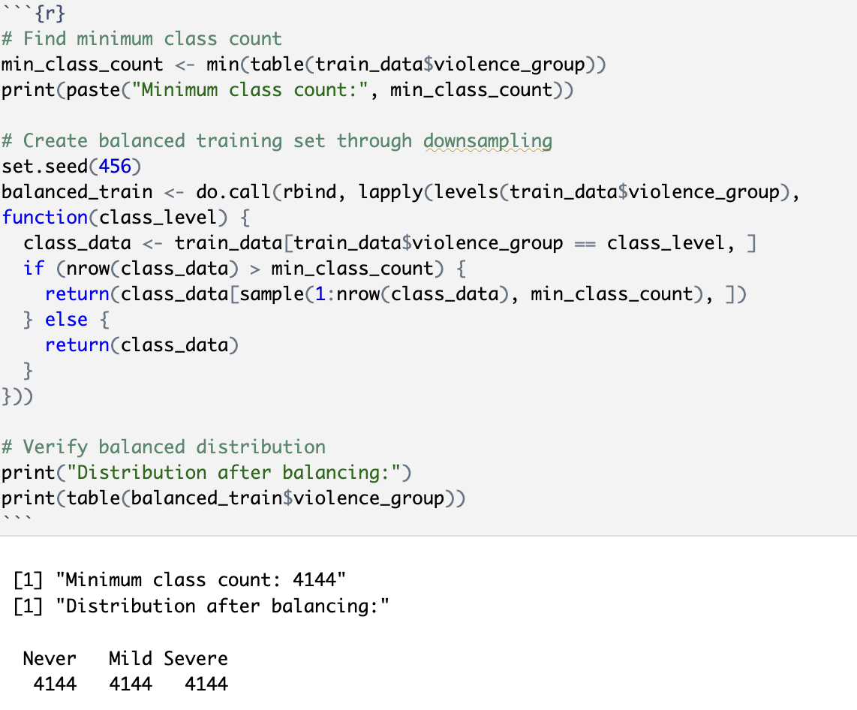
Machine Learning Model —— Violence
Supervised Classification Problem
Random Forest
XGBoost
Data Preprocess：
70% training data and 30% test data.
downsampling within the training data
Notes:
To predict experiences of violence, I framed the problem as a multi-class classification task."
"I tested two models:"
RF is highly effective at capturing complex, non-linear relationships between predictors
Unlike traditional decision trees, XGBoost refines its predictions iteratively, making it more effective at handling structured data. It is particularly well-suited for imbalanced datasets
As last slides says, The distribution of violence severity in the training data shows a significant class imbalance
To address this, we applied downsampling within the training data.
we split the dataset into 70% training data and 30% test data.

Slide 13
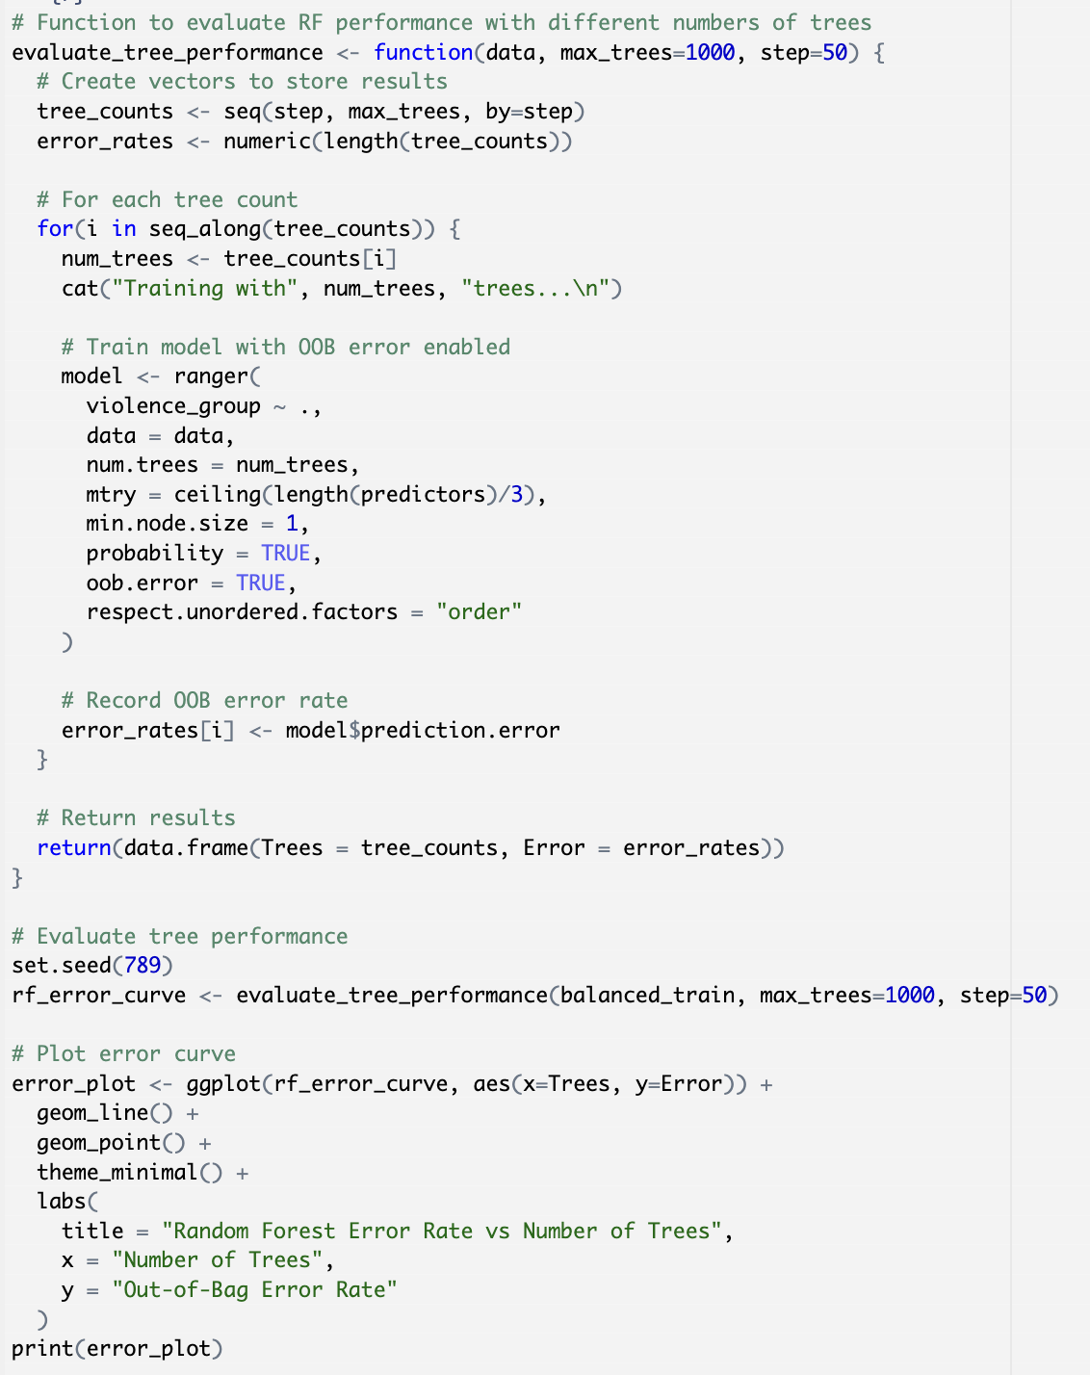
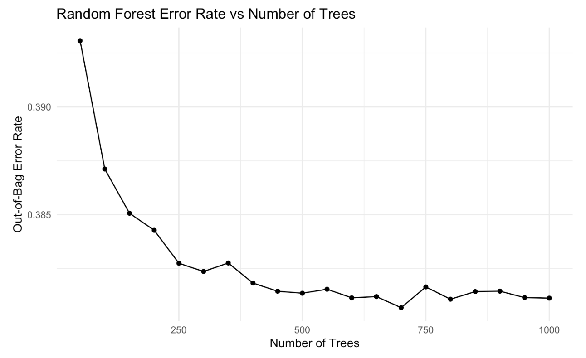
Random Forest —— Violence
Notes:
To optimize the performance of the Random Forest (RF) model, we conducted a hyperparameter tuning process by training multiple models with different numbers of decision trees, ranging from 50 to 1000
As shown in the OOB error curve gradually plateaus around 700 trees, indicating that adding more trees does not significantly improve the model’s performance.

Slide 14
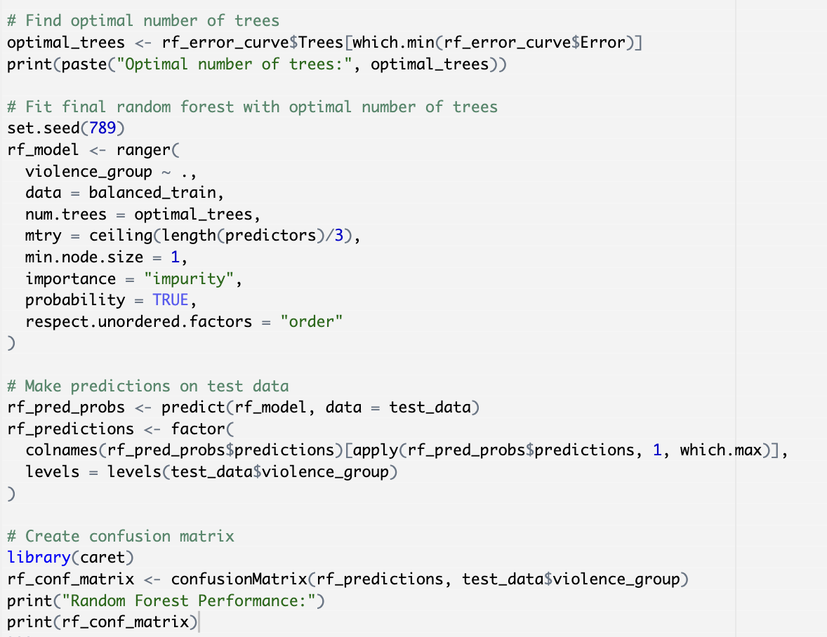
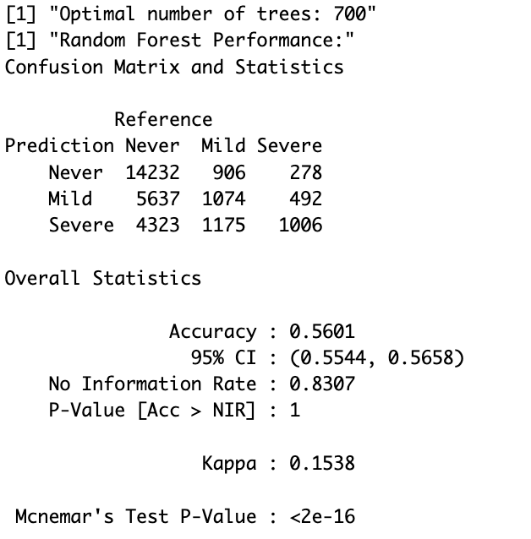
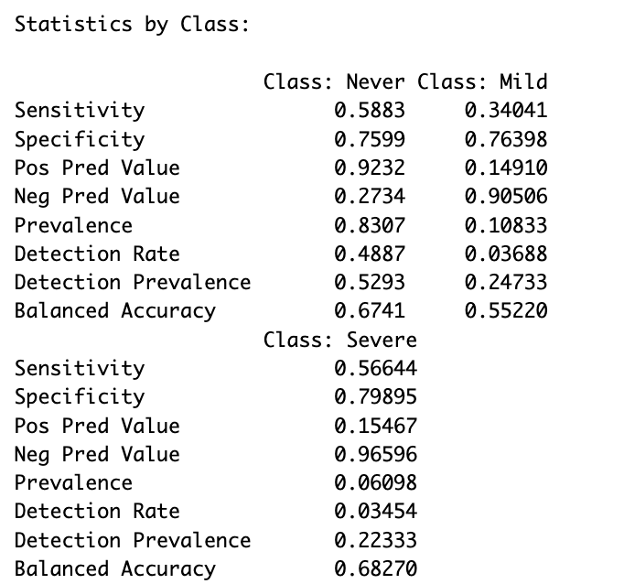
Random Forest —— Violence
Notes:
we selected 700 trees as the optimal number for our final RF model.
a moderate overall accuracy of 56.01%
The model demonstrates relatively strong performance in identifying cases where individuals never experienced violence, However, detecting the mild and severe categories proves more challenging, with a sensitivity of 34.04% for mild cases and 56.64% for severe cases.

Slide 15
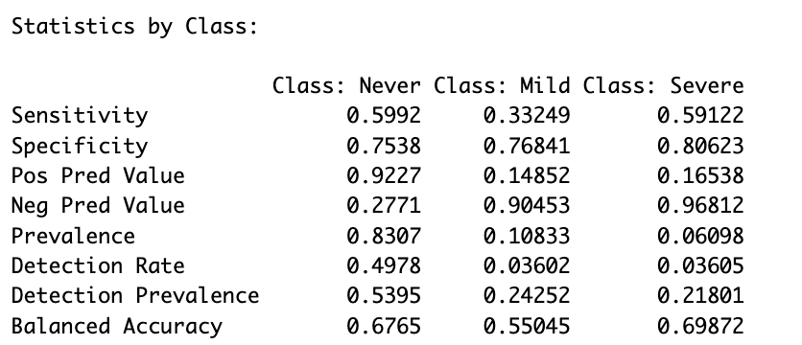
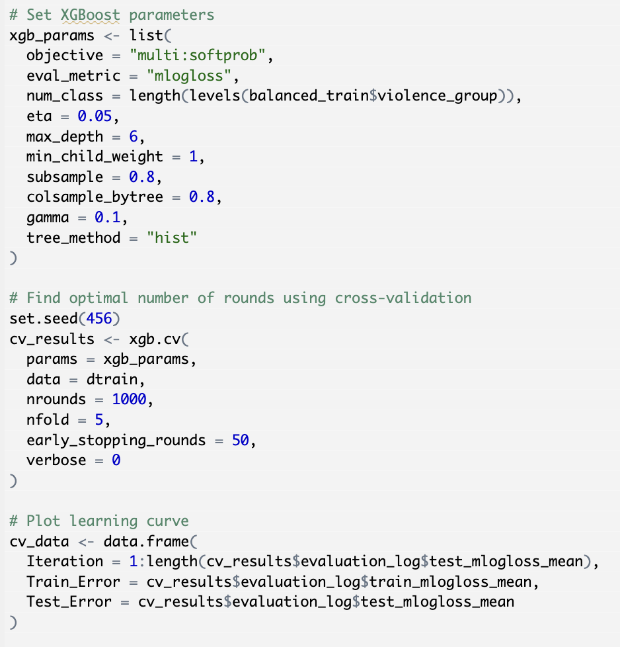
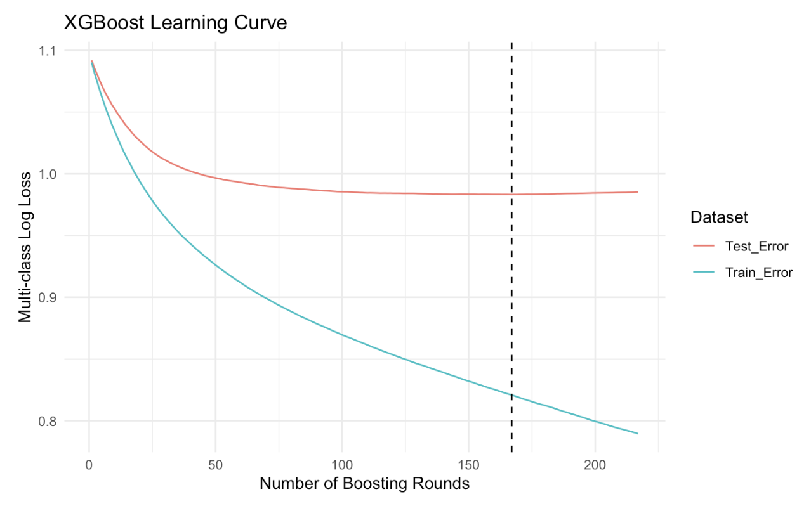
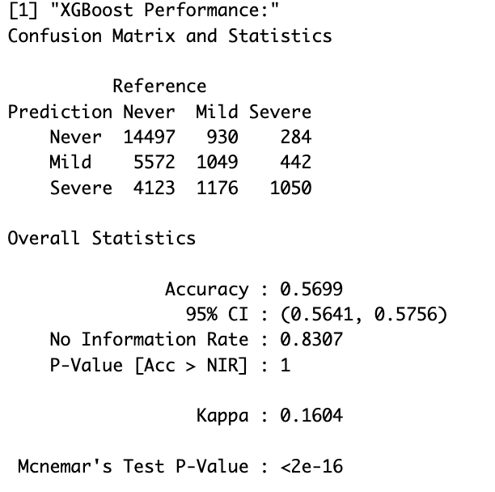
XGBoost —— Violence
Notes:
To optimize the XGBoost model, we set the maximum number of boosting rounds to 1000 and applied early stopping with a threshold of 50 rounds to prevent overfitting. Additionally, we performed five-fold cross-validation to ensure the model's performance was evaluated robustly across different training subsets.
The learning curve suggests that additional boosting beyond 167 rounds does not improve generalization and may lead to overfitting.
Based on this, we selected the 167th boosting round as the optimal stopping point for the final model.
The confusion matrix and performance metrics for the XGBoost model on the test dataset indicate a slight improvement over the Random Forest model. The overall accuracy of XGBoost reached 56.99%
the model demonstrated better detection of severe cases, achieving a sensitivity of 59.12% compared to Random Forest’s 56.64%,
Given its overall better performance, we select XGBoost for further hyperparameter tuning to improve classification,

Slide 16
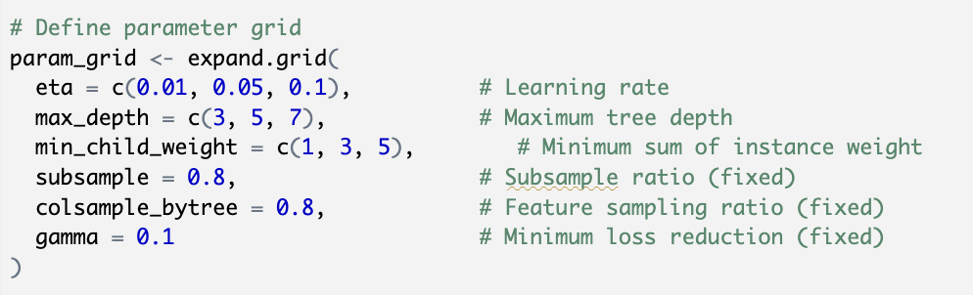
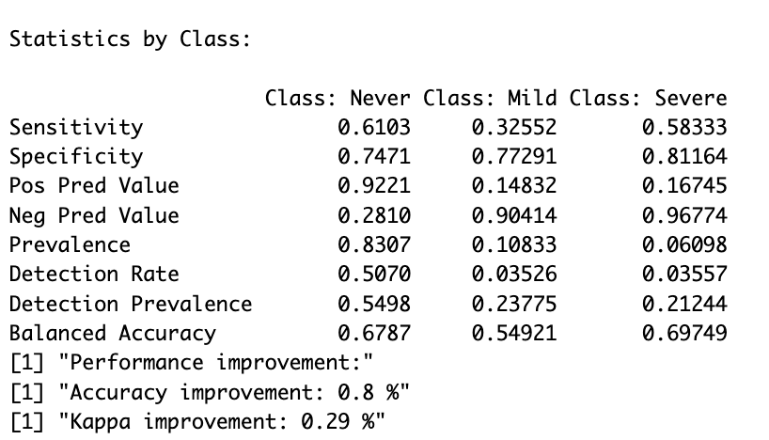
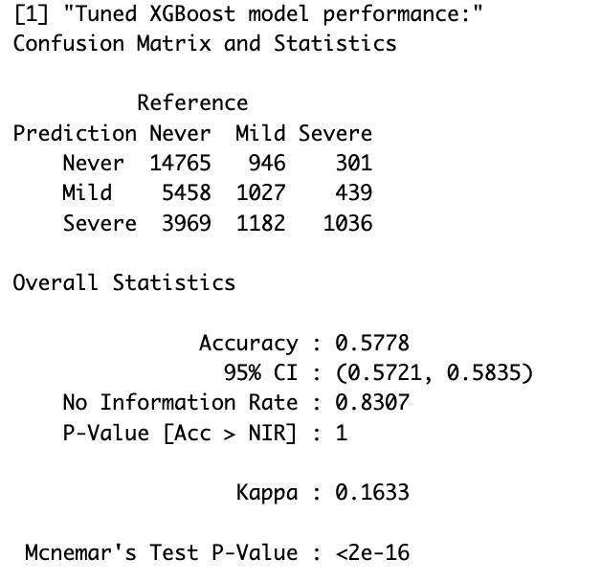
XGBoost Tuning—— Violence
the best-performing hyperparameter :
Learning rate (eta) = 0.05
Maximum tree depth = 3
Minimum child weight = 3
Notes:
"After hyperparameter tuning, XGBoost performed the best."
The overall accuracy increased to 57.78%
The model’s sensitivity improved across most categories, with the "Never" and "Severe" categories achieving higher detection rates, at 61.03% and 58.33%, respectively. The classification of "Mild" cases remains challenging, though specificity for this category increased slightly.

Slide 17
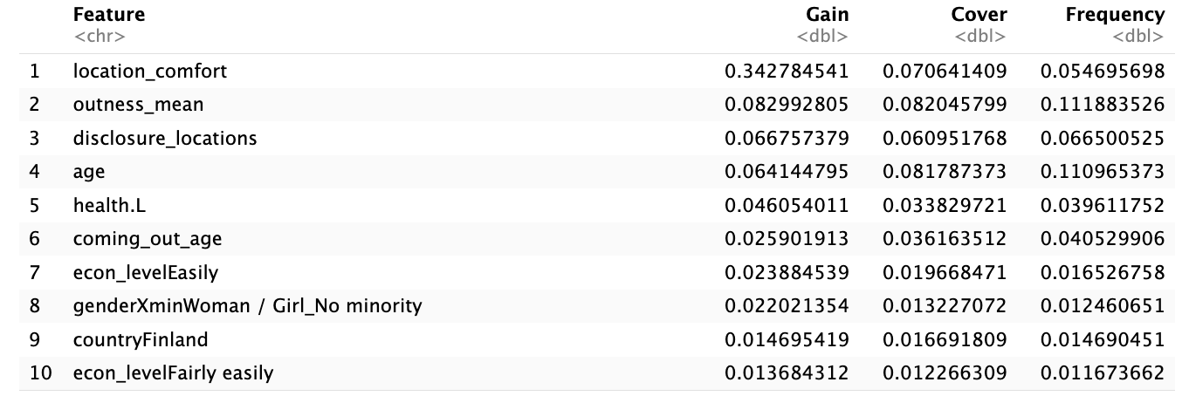
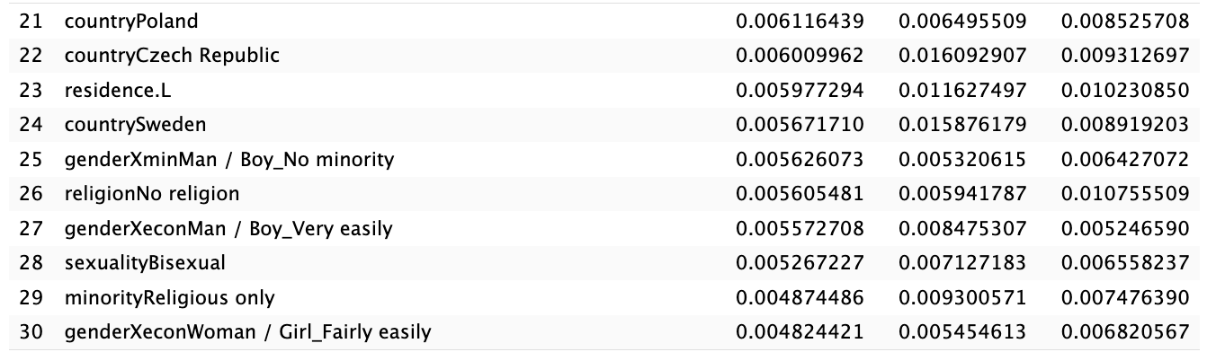
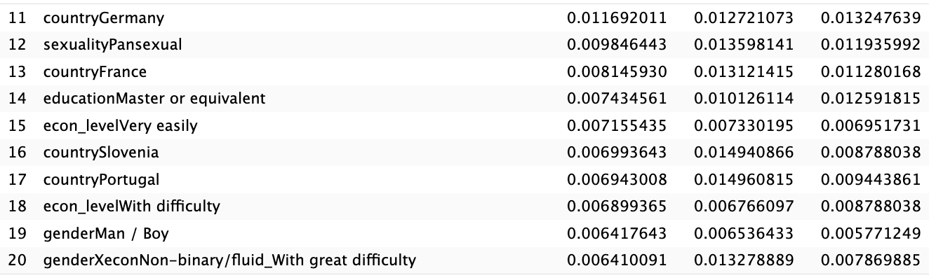
Feature Importance—— Violence
Notes:
We extracted the top 30 most important features used in the final XGBoost model. The results confirm that identity-related factors, including gender, sexual orientation, minority status, and economic level, are among the most significant predictors of violence experiences.
In addition to these expected predictors, the analysis also revealed Location comfort Outness mean & disclosure locations Health status: Country-level factors

Slide 18
Machine Learning Models—— Discrimination
supervised regression problem
Lasso Regression
Random Forest
XGBoost
70% training data and 30% test data
feature standardization on continuous predictors
applied z-score normalization (centering and scaling)
Notes:
As identified in the exploratory data analysis (EDA), the discrimination variable is a right-skewed continuous variable. As this is a supervised regression problem, we choose the three models below.
Lasso Regression: Suitable for high-dimensional data and effective in feature selection by shrinking less relevant predictors to zero.
Random Forest: A non-parametric ensemble model capable of capturing non-linear relationships and complex interactions between predictors,
XGBoost Its ability to handle imbalanced and non-linear relationships
To ensure consistency across models, we split the dataset into 70% training data and 30% test data. Since Lasso regression requires standardized input variables, we performed feature standardization on continuous predictors.

Slide 19
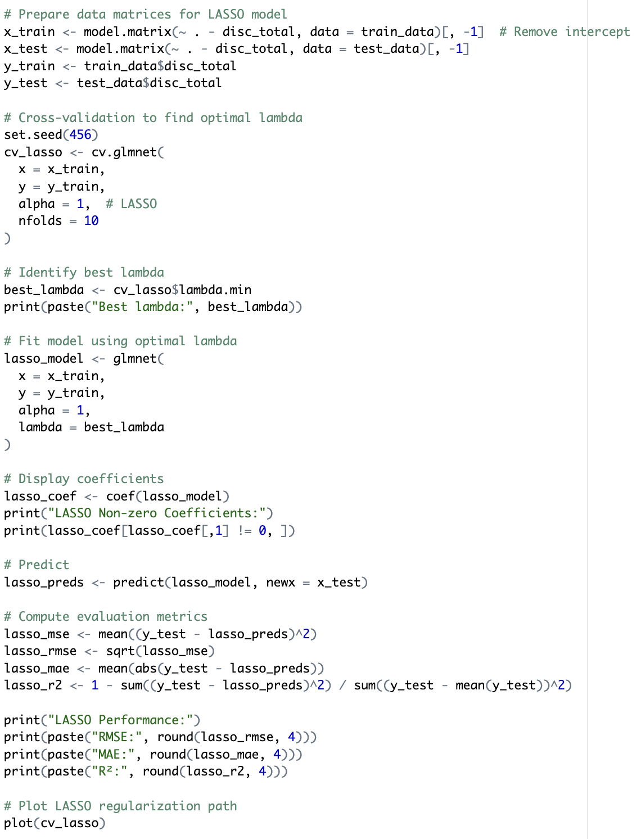
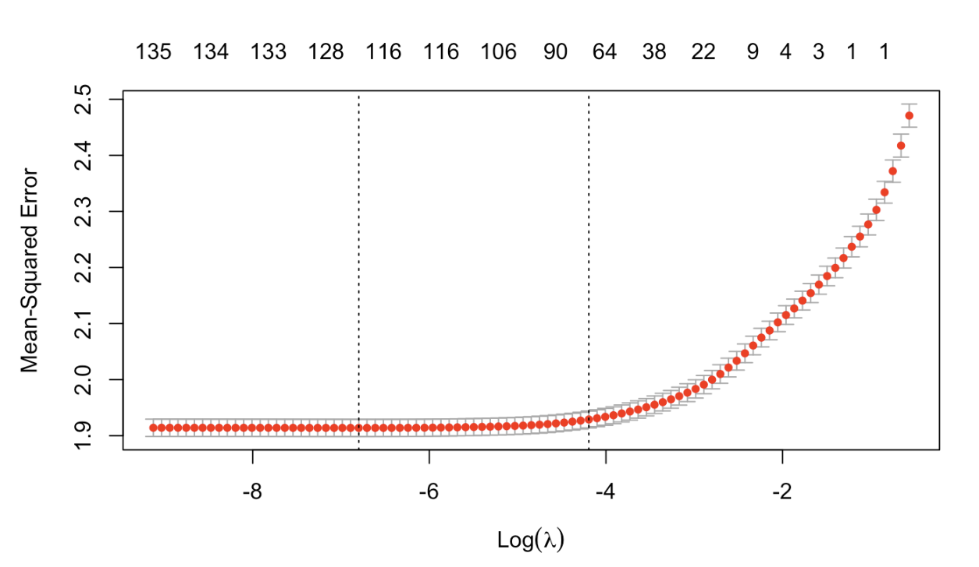
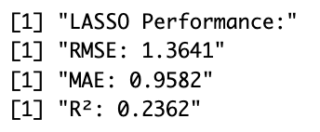
Lasso Regression —— Discrimination
Notes:
The Lasso model was trained using 10-fold cross-validation to determine the optimal lambda value, which was found to be approximately 0.0011.
In terms of performance, the model achieved an RMSE of 1.3641 and an MAE of 0.9582, suggesting moderate predictive accuracy.

Slide 20
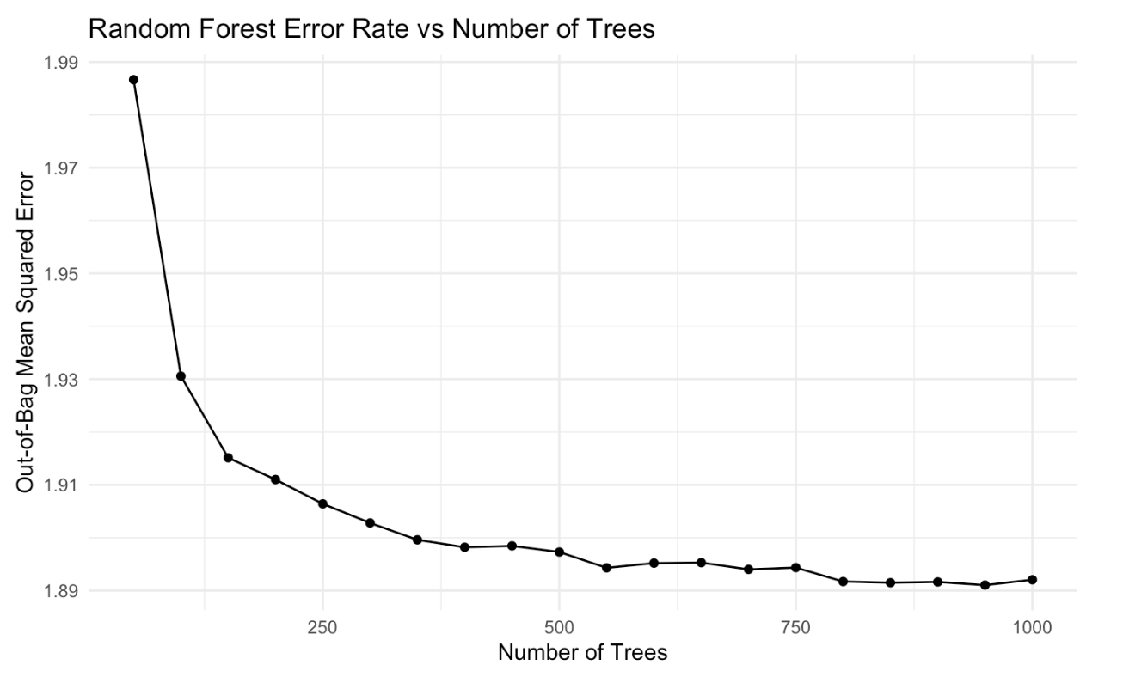
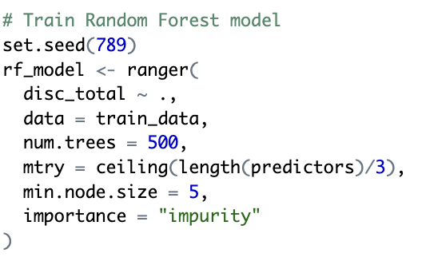
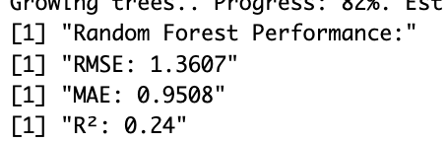
Random Forest —— Discrimination
Notes:
For the Random Forest model, we set the minimum node size to 5, which helps to balance model complexity and prevent overfitting while allowing sufficient depth for meaningful splits.
Similar to the previous section, we evaluated models with up to 1000 trees, increasing in increments of 50, to identify the point at which the out-of-bag (OOB) error stabilizes.
The final model achieved an RMSE of 1.3607, an MAE of 0.9508, and an R² of 0.24. These results indicate that while the model captures some variation in the discrimination variable, there is room for improvement in predictive power.

Slide 21
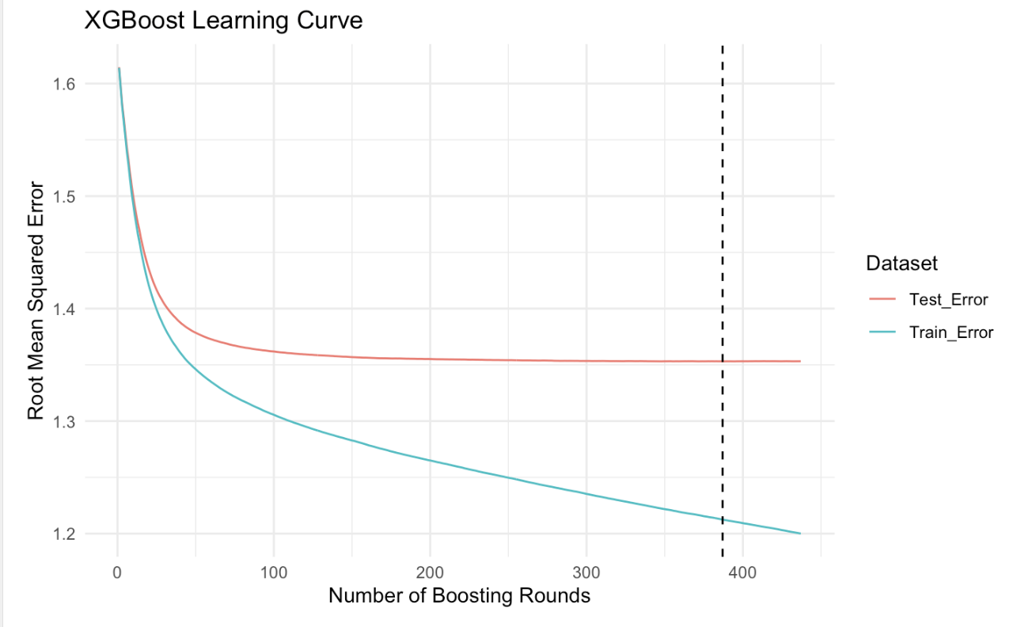
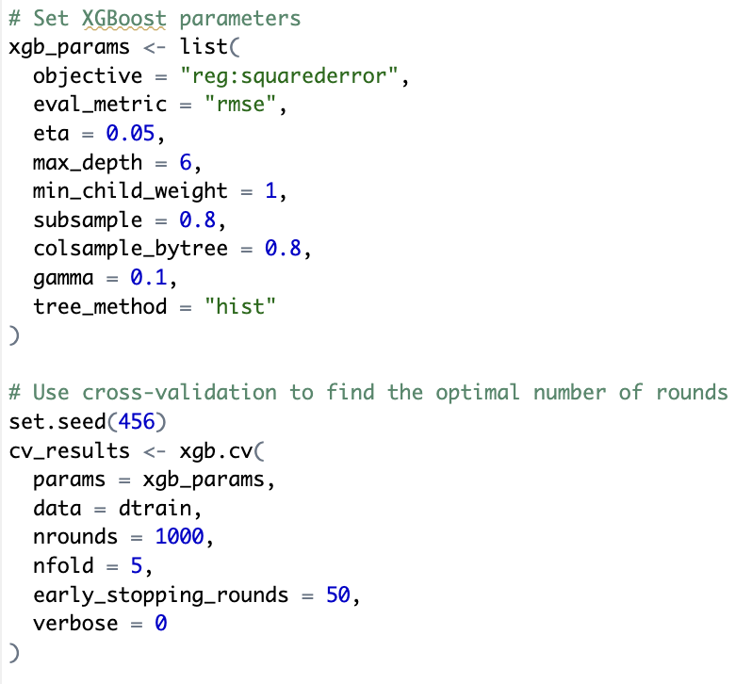
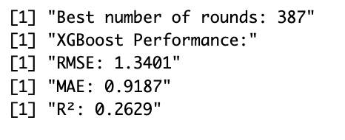
XGBoost —— Discrimination
Notes:
For XGBoost, we fine-tuned hyperparameters using 5-fold cross-validation to determine the optimal number of boosting rounds. The model was trained with a learning rate of 0.05, a maximum depth of 6, and an early stopping criterion to prevent overfitting.
The RMSE of XGBoost is 1.3401, and the MAE is 0.9187, indicating better predictive accuracy. The R² value increased to 0.2629, suggesting that XGBoost captures a greater proportion of variance compared to Lasso.

Slide 22
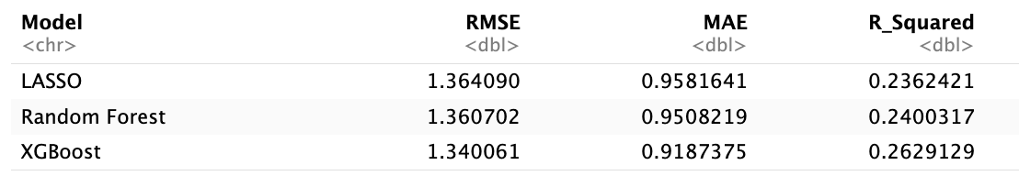
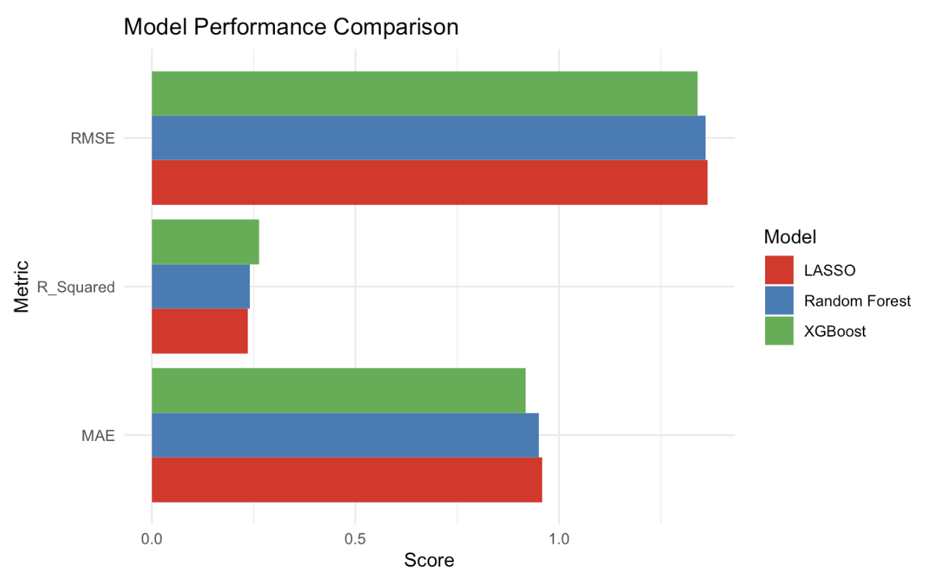
Model Comparison —— Discrimination
Notes:
Overall, since XGBoost consistently outperforms the other two models across key metrics, we select it for further hyperparameter tuning to enhance its predictive accuracy and generalization capability.

Slide 23
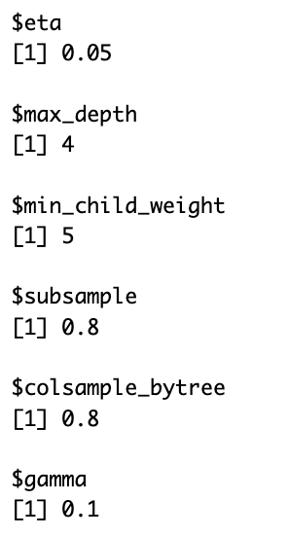
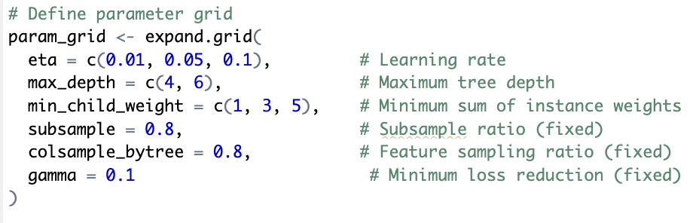
XGBoost Tuning —— Discrimination
Compared to the initial XGBoost model:
Best RMSE: 1.3369 (improvement: 0.24%)
Best MAE: 0.9185 (improvement: 0.03%)
Best R²: 0.2664(improvement: 1.34%)
Notes:
we performed hyperparameter tuning using a grid search approach.
and achieve the best model performance at 675 boosting rounds. The results of the tuned XGBoost model are as follows:
Best RMSE: 1.3369
Best MAE: 0.9185
Best R²: 0.2664

Slide 24
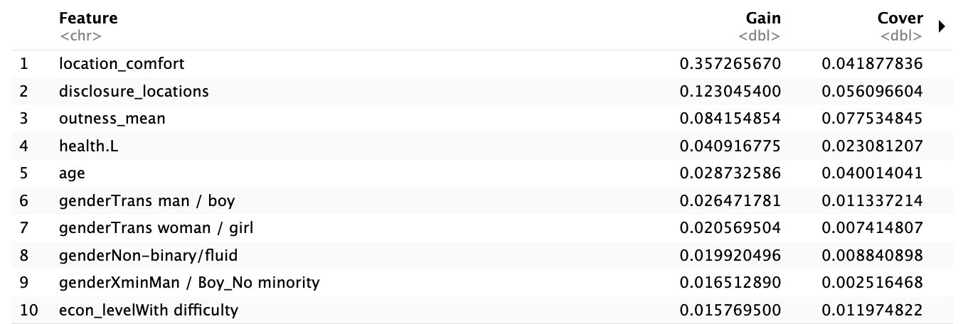
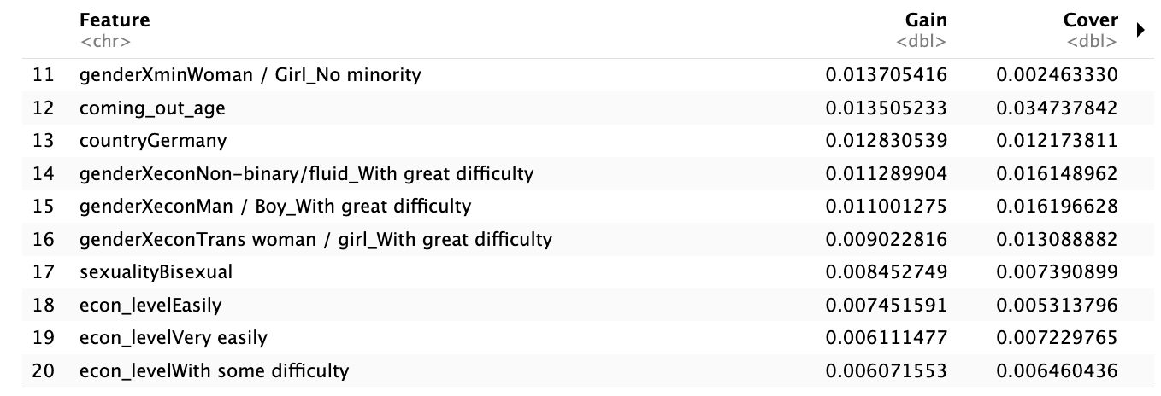
Feature Importance —— Discrimination
Notes:
Following model tuning, we extracted feature importance rankings and identified the top 20 most influential predictors.
The results indicate that variables related to gender identity, sexual orientation, minority status, and economic conditions play a significant role in predicting the outcome, aligning with our initial hypothesis.
In addition to these expected predictors, the analysis also revealed several noteworthy influential features

Slide 25
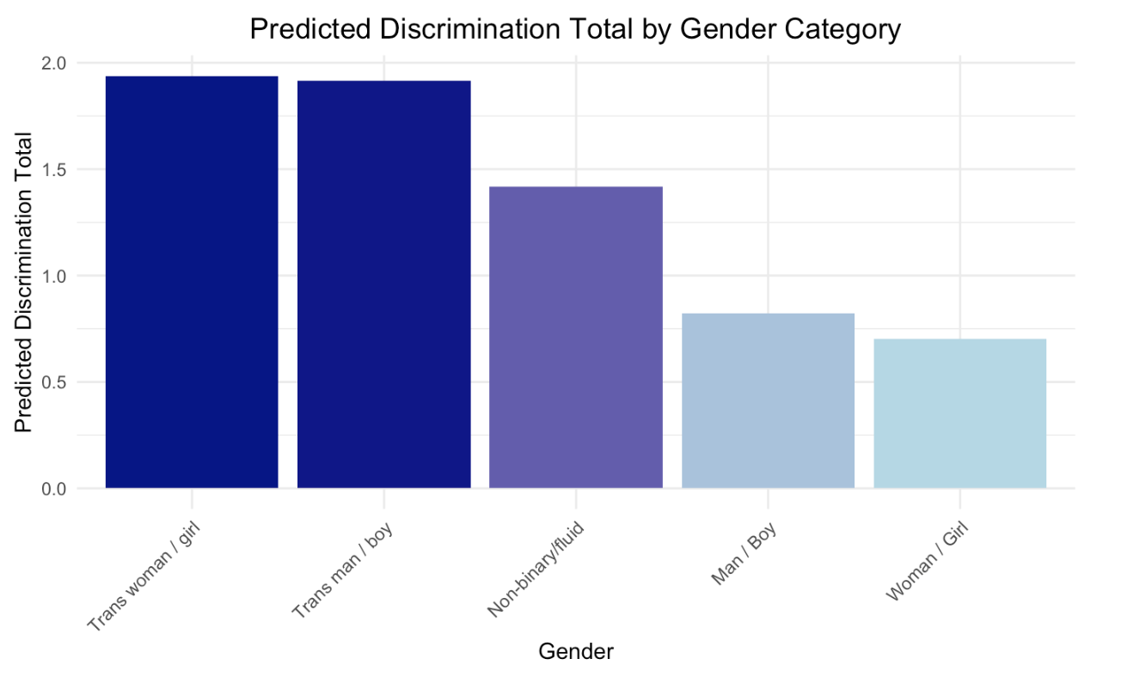
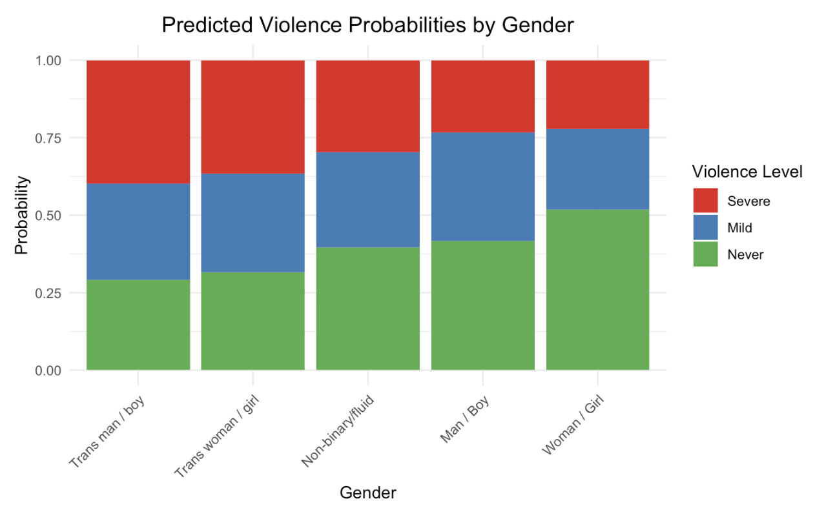
Findings —— Gender
Notes:
To better address the research question, we utilized the test dataset to predict the level of violence and discrimination experienced by individuals of different gender identities and minority statuses. To ensure comparability, predictions were made while holding all other variables at their mean values.

Slide 26
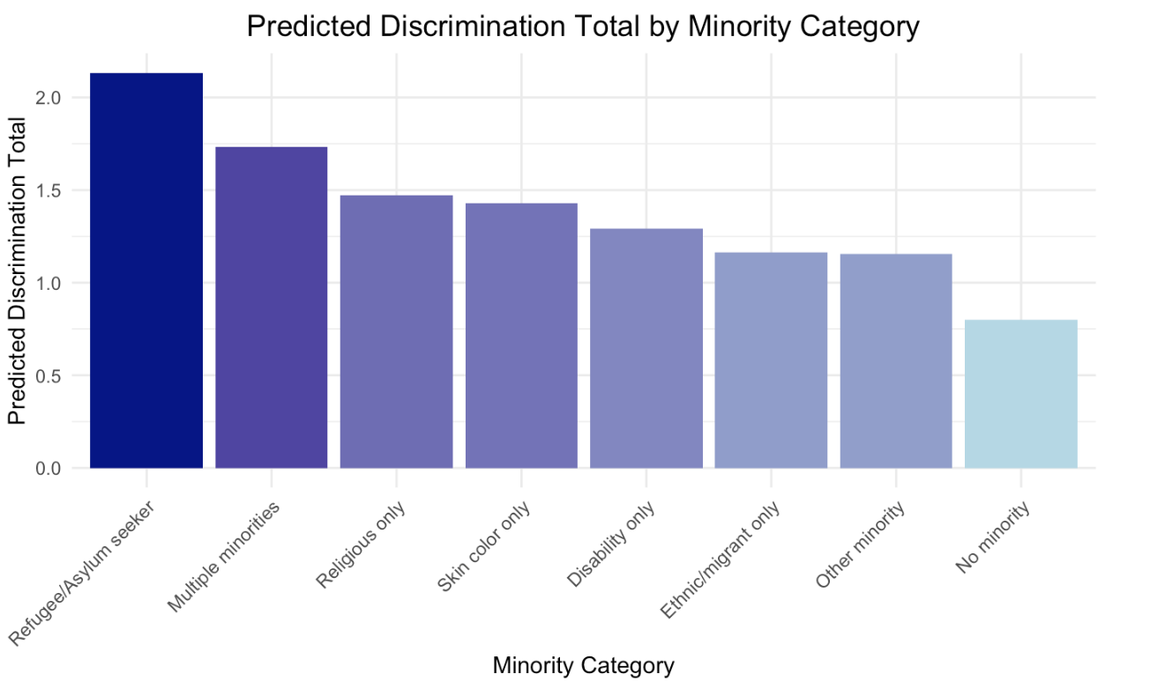
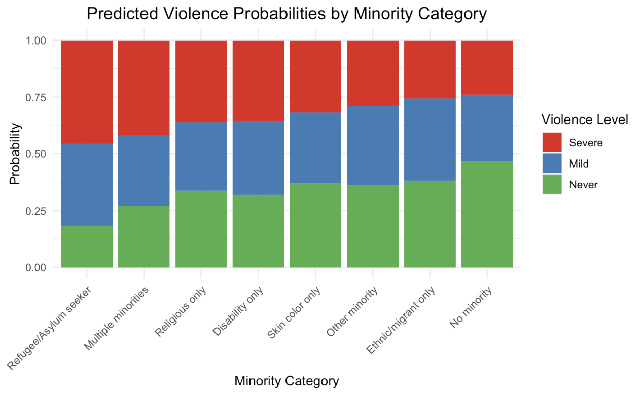
Findings —— Minority
Notes:
Similarly, we examined the impact of minority group status on experiences of violence and discrimination.
individuals who are refugees or belong to multiple minority categories experience a disproportionately high probability of severe violence and discrimination

Slide 27
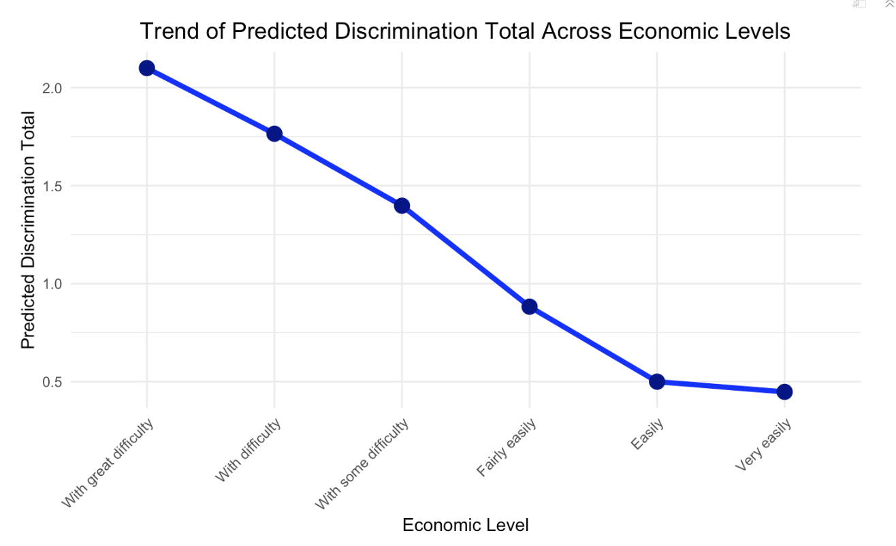
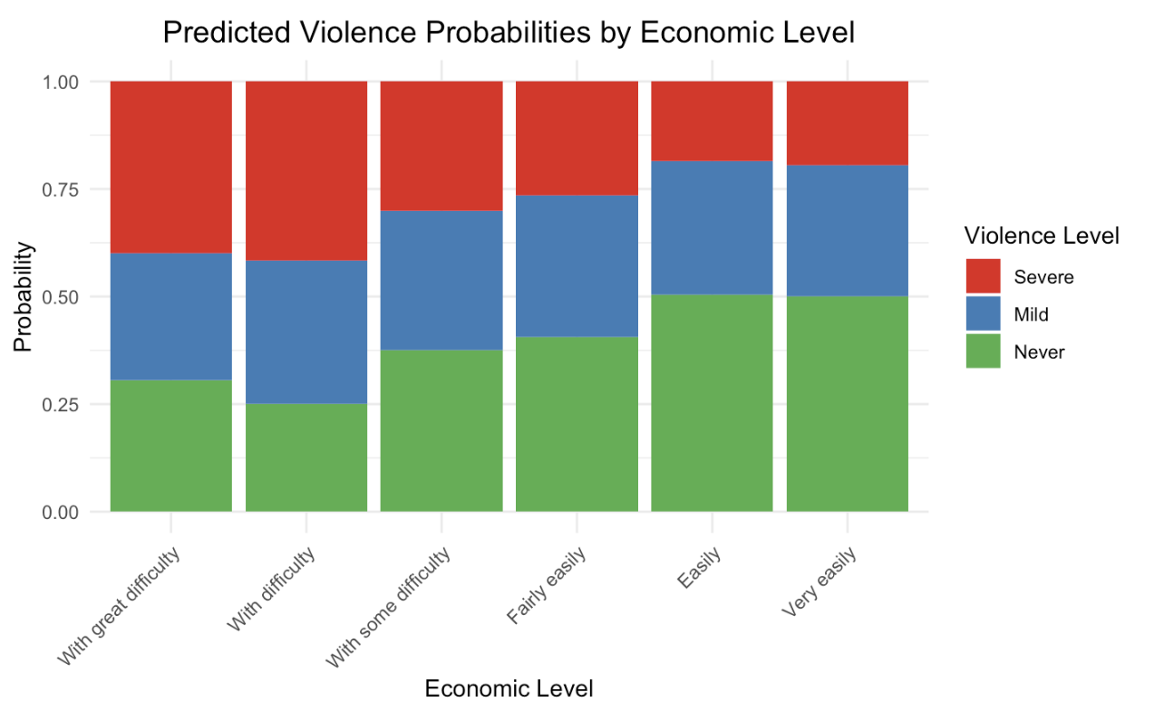
Findings —— Economic Level
Notes:
whereas those who report financial stability (“easily” or “very easily”) have the lowest probability to face disc and violence

Slide 28
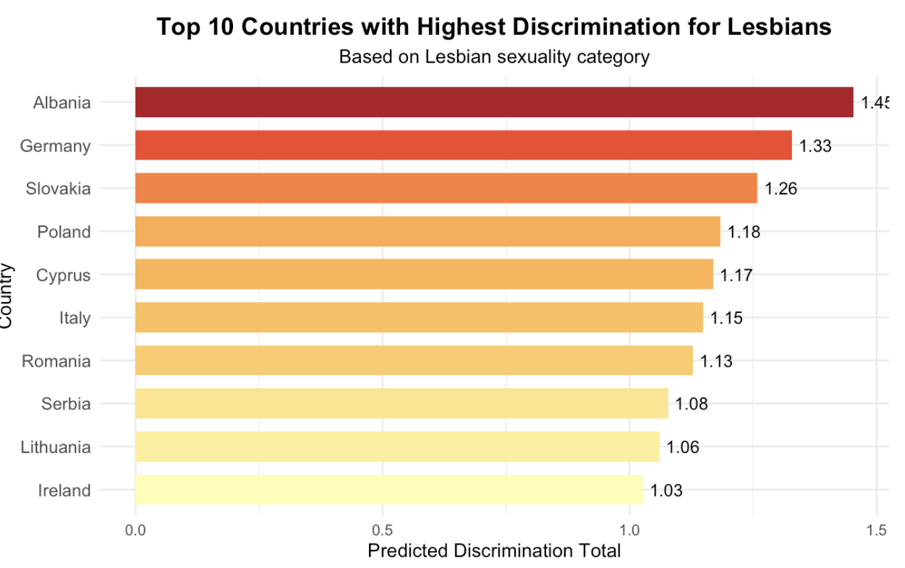
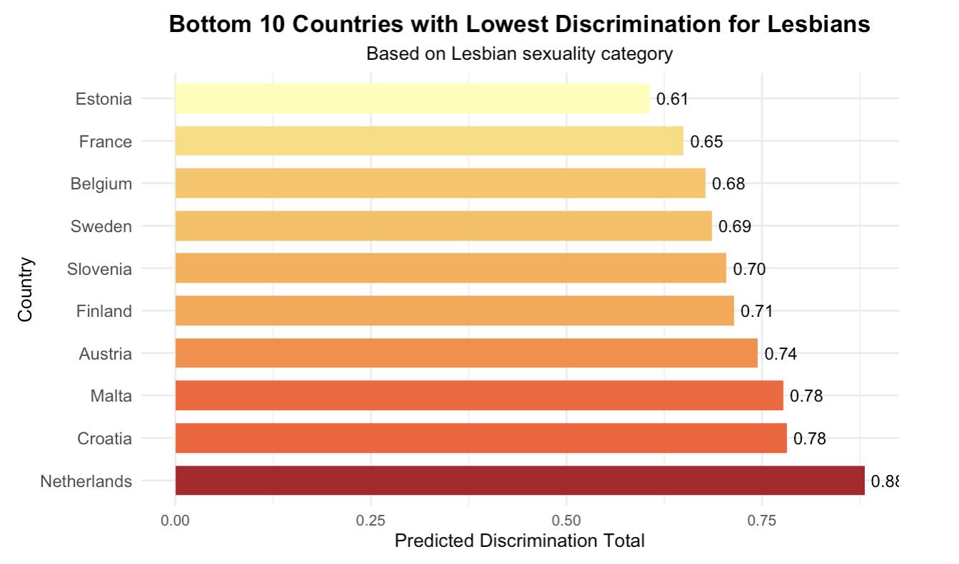
Findings —— Lesbian discrimination in different countries
Notes:
To better support policy improvements, we attempt to predict discrimination against lesbians in different countries.
The charts show that, countries with the highest predicted discrimination include Albania, Germany, Slovakia, and Poland, with Albania showing the most severe discrimination levels. Also, countries with the lowest predicted discrimination include Estonia, France, Belgium, and Sweden, with Estonia having the least discrimination.
These findings suggest substantial cross-national variation in the treatment of lesbians, likely influenced by differences in legal protections, cultural attitudes, and broader LGBTQ+ rights policies.

Slide 29
Key Takeaways
🌍 Who Faces the Highest Risk?
Transgender & non-binary individuals
Low-income individuals
Multiply marginalized groups (e.g., racial, ethnic, religious minorities)
📊 What Did the Models Reveal?
XGBoost outperformed Lasso and Random Forest in predicting discrimination and violence.
Key predictors: Gender identity, economic status, location comfort, and outness level.
Country-level differences: Discrimination varies across nations, with some providing safer environments.
Notes:
🔹 Social Science Insights:
Trans, low-income, and multiply marginalized individuals faced the greatest risks.
Discrimination is not uniform—country policies and cultural factors matter.
Machine Learning Findings:
XGBoost outperformed other models in both violence and discrimination prediction.
Gender identity, economic status, and location comfort were the top predictors.

Slide 30
Implications & Next Steps
Policy interventions
Better data representation is needed for minority subgroups to improve predictive accuracy.
Future research should explore longitudinal trends and additional socioeconomic factors.
Notes:
Intersectional policy interventions to protect vulnerable groups.
Better data representation for minority subgroups in predictive modeling.
Future research to track long-term discrimination trends using longitudinal data.*

Slide 31

Thank you！

